Slide 1
MGT 217
11/7/18

Slide 2
“You Guys”

Slide 4
What Is Communication?

Slide 5
The Role of Effective Communication in Influencing Others
We define communication as the act of transmitting thoughts, processes, and ideas through a variety of channels.
Notes:
In an increasingly connected world, communication is more important than ever in the workplace. Today’s organizations have no choice but to adapt quickly to the rise of new technologies and social networking tools in order to keep up with the competition and stay in touch with the needs of their customer base. We define communication as the act of transmitting thoughts, processes, and ideas through a variety of channels. Efficient communication leads to better functioning of organizations, which benefits both employees and customers. Inside the organization, effective communication must also take place within and among peer groups and between different hierarchical levels. One of the most important roles of a manager is to encourage and nurture a collaborative working environment by effectively communicating with teams to ensure tasks are accomplished and organizational goals are achieved.

Slide 6
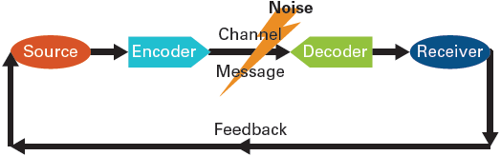
Shannon−Weaver Communications Model
The Role of Effective Communication in Influencing Others
Figure 13.1: Shannon-Weaver Communications Model
Notes:
In 1947, mathematician Claude E. Shannon created a communication model, later developed by Warren Weaver. Though almost 70 years old, it is still the cornerstone of communication models and is still in use today. It is called the Shannon−Weaver model. This model of communication has two main components: the sender of the message, also known as the source, and the receiver of the message. When the sender transmits a message through a communication channel, which is the route the message travels along, the content of the message is encoded into its intended meaning through different formats such as written, oral, or electronic; the receiver then decodes or interprets the message into a perceived meaning. The receiver provides feedback or a response to the sender to confirm the message has been received and its meaning understood.

Slide 7
Media Richness Theory
Ability to transmit as much information as possible
The richer the medium, the better the information is received
The richer the medium, more communication cues are available, and more back-and-forth can occur

Slide 8
Rank the Following:
Email
Video chat
In-person communication
Text/Instant messaging
Blog/Newsletters
Telephone conversations
Notes:
Most media rich to least:
In-person communication
Video chat
Telephone
Text/Instant messaging
Email
Blog/newsletters

Slide 9
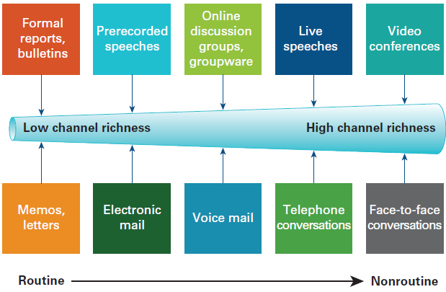
Figure 13.3: Channel Richness
Types of communication channels
SOURCE: Based on Lengel, R. H., and D. L. Daft. “The Selection of Communication Media as an Executive Skill.” Academy of Management Executive (August 1988): 225–232; Daft, D. L., and R. H. Lengel. “Organizational Information Requirements, Media Richness, and Structural Design.” Managerial Science (May 1996): 554–572. Reproduced from R. L. Daft and R. A. Noe. Organizational Behavior (Fort Worth, TX: Harcourt, 2001), 311. (c) 2007 Prentice Hall Inc. All rights reserved.
Notes:
The second-richest channel is the phone. During phone conversations we are able to listen to verbal cues, detect levels of emotion, and pick up on nonverbal cues such as tone of voice. Despite their popularity, emails, text messages, blogs, memos, e-bulletins, and so on are considered to be at the lower end of channel richness, especially when the information becomes sensitive or complex. By far the most effective way of resolving a situation or dealing with a difficult issue is to call a face-to-face meeting or pick up the phone.

Slide 10
When should we use…?
Richer forms of communication
  Complex and contentious issues
Less rich forms of communication
  Simple tasks
  Confirmation and record-keeping (e.g. email)
For exam: Know the hierarchy of media richness and when to use more/less!
(--WARNING--: Too many people in the workplace get this wrong; you will see it! Don’t be one of them!)

Slide 11
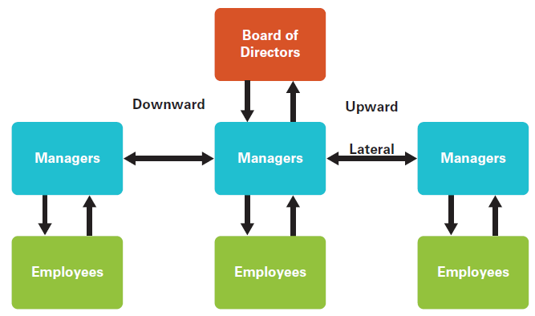
Communicating in Organizations
Figure 13.5: Three Directions of Communication in Organizations
SOURCE: Based on Lunenburg, Fred C. “Formal Communication Channels: Upward, Downward, Horizontal, and External.” Focus on Colleges, Universities, and Schools 4, no. 1 (2010). www.nationalforum.com/Electronic%20Journal%20Volumes/Lunenburg,%20Fred%20C,%20Formal%20Comm%20Channels%20FOCUS%20V4%20N1%202010.pdf.
Notes:
The flow of communication in an organization can move in three main directions depending on how an organization is structured.

Slide 12
Upward Communication
Communicating in Organizations
Upward communication sends messages from the lower levels of the organizational hierarchy to the higher levels.
Notes:
Upward communication sends messages from the lower levels of the organizational hierarchy to the higher levels. Some organizations value feedback, suggestions, and advice from lower level employees who are “on the ground” and may be closer to knowing the needs of the customer. For example, employees at U.S. chicken restaurant Chick-fil-A came up with Frosted Lemonade, a combination of fresh-squeezed lemonade and ice cream. The drink has caught on with customers as a snack option that is lighter than a full milkshake. These employees are also encouraged to share any problems or thoughts they have about the organization and their roles and provide recommendations for improvement. If lower level employees do not effectively communicate with their superiors and instead withhold or filter information, this can leave those at the higher levels ignorant of what is really going on in the organization.

Slide 13
Grapevine
Communicating in Organizations
Grapevine is the unofficial line of communication between individuals or groups.
Notes:
One of the main forms of informal network is the grapevine, the unofficial line of communication between individuals or groups.³ Grapevines are a useful method of communicating messages quickly and efficiently in person, over emails, blogs, or through other technological tools. They can bring about a sense of unity among the employees who meet and share information. However, they are more common where management keeps employees in the dark about what is going on in the organization. Indeed, much of what is said on the grapevine can be inaccurate and is usually based on rumor. As some employees have discovered, missteps on modern-day grapevines like blogs can lead to termination. For example, former Google employee Mark Jen was fired for criticizing his employer through his blog, and a Delta Airlines flight attendant was fired for posting suggestive pictures of herself in uniform on her blog.

Slide 14
Gossip Chains
Communicating in Organizations
Gossip chains are communication networks in which one individual creates and spreads untrue or inaccurate information to others through the organization.
Notes:
Grapevines also give rise to gossip chains, communication networks in which one individual creates and spreads untrue or inaccurate information to others through the organization.¹⁵ Each person who hears the gossip has the choice to keep it confidential or to pass it on. For example, one employee might spread gossip to others to discredit an unpopular supervisor. In contrast, a cluster chain consists of a group of people who broadcast information only within their group.¹⁶ In both gossip chains and cluster chains, the information moves very quickly and can be damaging to an organization regardless of management’s confirming or denying the rumors. Successful organizations actively control rumors and gossip through effective, honest, and consistent communication.¹⁷

Slide 15
Barriers to Communication
What problems come up when we’re trying to communicate effectively?

Slide 16
Barriers to Communication
Filtering
Emotions
Information overload
Differing perceptions
Notes:
Filtering: When someone screens and then manipulates a message from a sender before passing it on to the intended receiver, that person has filtered the message.
Emotions: Our emotions have an effect on the way we communicate. When we are happy and relaxed, we are more likely to accept constructive criticism in a positive way and convey our messages succinctly and accurately. However, when we are stressed or angry, we might snap at others or feel attacked or defensive when someone tries to offer advice. It is essential that we are aware of our emotions and keep them in check before they spiral out of control.
Information overload: At times, we can become overwhelmed by the wealth of information surrounding us. This can lead us to make hasty decisions or lose our ability to prioritize. Being able to prioritize our workload helps us to make better decisions and prevents us from getting overloaded by information. Svetlana dishonestly cites “information overload” as one of the reasons Langston wants to leave the lending department.
Differing perceptions: Sometimes the way we interpret situations clashes with the perceptions of others, leading to confusion and misconception. We can overcome this communication barrier by challenging our own assumptions about other people and situations, and by seeking advice from others to clarify our perceptions. Proper training for employees in organizations helps to align perceptions. For example, Sonia notes the perceptual differences between Langston and Svetlana and promises Langston she will talk to Svetlana to clear up the misunderstanding.

Slide 17
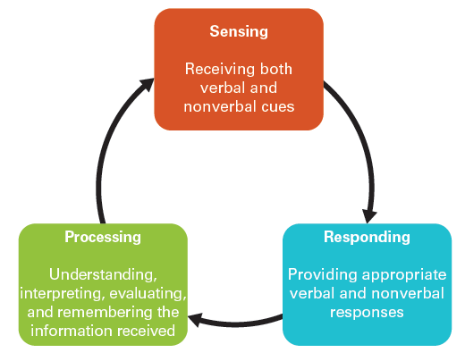
The Active Listening Process
Barriers to Communication
Figure 13.4: The Active Listening Process
SOURCE: Based on Comer, Lucette B., and Tanya Drollinger. “Active Empathetic Listening and Selling Success: A Conceptual Framework.” Journal of Personal Selling and Sales Management 19, no. 1 (Winter 1999): 15–29.
Notes:
Failure to listen properly in organizations can lead to misunderstandings that can damage personal and work relationships. Ineffective listening also comes at a high price A way to overcome poor listening is through active listening, which consists of concentrating on the true meaning of what others are saying. It is an essential skill for employees in the workplace because it allows the receiver to hear and understand the message, and reassures the speaker that the message has been heard in the same terms in which it is delivered. There are three main components to active listening: sensing, processing, and responding.
Sensing means paying attention to the signals sent from the speaker. The listener avoids forming an opinion or interrupting the speaker until he or she has finished and consciously remains attentive to what the speaker is saying.
Processing means actively understanding and remembering what is being said, as well as making an effort to empathize with the speaker’s feelings and thoughts and the situation at hand. Active listening also requires looking for nonverbal cues such eye contact or lack thereof, poor posture (slouching), and tone of voice (sarcastic, angry, confident, etc.) to really understand the entire message.

Slide 18
Cross-Cultural Communication: Low-context versus High-context Cultures
Cross-cultural Communication
Low-context cultures
High-context cultures
Notes:
Low-context cultures depend more on explicit messages conveyed through the spoken or written word. Most English-speaking and Germanic countries have a fast, direct, logical, efficient, “what you say is what you mean” communication style. In business environments in these countries there is less emphasis on interpersonal relationships and more on the individual. In contrast, in high-context cultures, most messages are conveyed through body language, nonverbal cues, and the circumstances in which the communication is taking place. According to Hall, many Middle Eastern and Asian cultures fall into this category. The Japanese, for example, have an indirect, intuitive, unemotional, contemplative, and passive style when it comes to negotiation. In short, what you say is not necessarily what you mean. High-context cultures value silence as a way of absorbing information and getting a sense of the people they are communicating with.

Slide 19
Other Complicating Factors
Cross-cultural Communication
Slang and idioms
Euphemisms
Proverbs
Verbal dueling
Humor
Notes:
Slang and idioms: Slang is informal language applied in a particular context or group.
Euphemisms: Most languages include euphemisms, vague or general words used in place of those considered to be too blunt or harsh.
Proverbs or wise sayings: These are also common to many different cultures. Common proverbs used in a business environment include: “A fool and his money are soon parted,” “Too many cooks spoil the broth,” and “Better late than never.”
Verbal Dueling: Certain cultural subgroups engage in verbal dueling, a form of competitive communication in which the participants exchange insults until one “wins.”
Humor: Most cultures value humor, but what is perceived to be funny in one culture can easily fall flat in another because some jokes are inappropriate for the audience or get lost in translation.

Slide 20
How to Communicate Better?

Slide 21
Overcoming Difficulties in Cross-Cultural Communication
Do your homework
Never make assumptions
Be an active listener
Make an effort to be supportive
Avoid slang, jargon, and euphemisms
Notes:
Do your homework and make sure you are familiar with the language and customs of different cultures.
Never make assumptions: it is better to believe there are differences until similarities have been established.
Be an active listener and summarize points to confirm you understand what the other party has said.
Make an effort to be supportive, encouraging, and empathic particularly towards those for whom English is a second language.
Avoid slang, jargon, and euphemisms because they often cause confusion.

Slide 22
TED video
https://www.ted.com/talks/celeste_headlee_10_ways_to_have_a_better_conversation
Notes:
First 15 minutes

